Slide 1



Telengana Weather Dashboard
View in Power BI

Slide 2
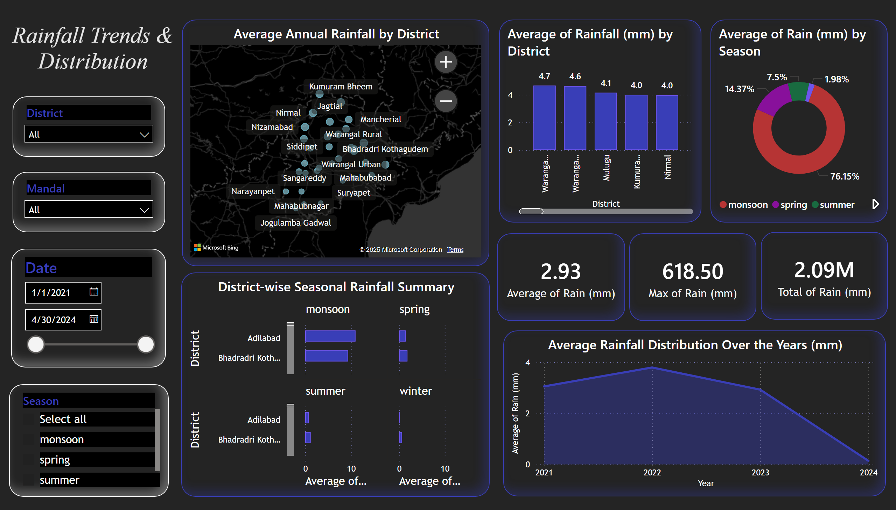
Rainfall Trends & Distribution
Notes:
Average of Rainfall (mm) by District
No alt text provided
Average Rainfall Distribution Over the Years (mm)
No alt text provided
DSlicer
No alt text provided
Mandal Slicer
No alt text provided
Date Slicer
No alt text provided
SeasonSlicer
No alt text provided
Average Annual Rainfall by District
No alt text provided
District-wise Seasonal Rainfall Summary
No alt text provided
donutChart
No alt text provided
logo
No alt text provided
card
No alt text provided
card
No alt text provided
card
No alt text provided

Slide 3
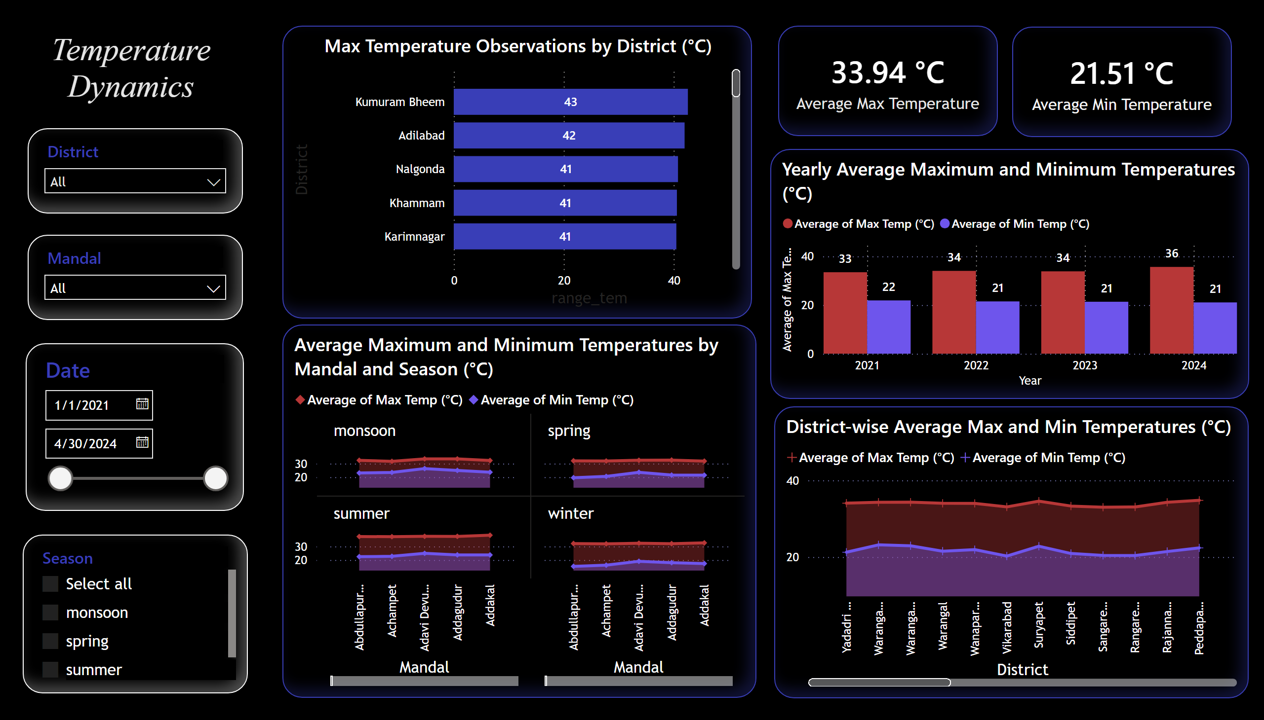
Temperature Dynamics
Notes:
District-wise Average Max and Min Temperatures (°C)
No alt text provided
Average Maximum and Minimum Temperatures by Mandal and Season (°C)
No alt text provided
Yearly Average Maximum and Minimum Temperatures (°C)
No alt text provided
Max Temperature Observations by District (°C)
No alt text provided
card
No alt text provided
card
No alt text provided
logo
No alt text provided
DSlicer
No alt text provided
Mandal Slicer
No alt text provided
Date Slicer
No alt text provided
SeasonSlicer
No alt text provided

Slide 4
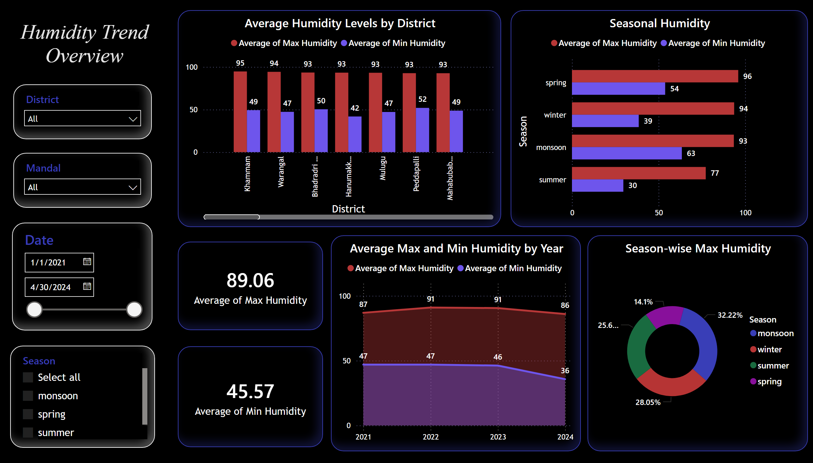
Humidity Trend Overview
Notes:
slicer
No alt text provided
image
No alt text provided
slicer
No alt text provided
slicer
No alt text provided
slicer
No alt text provided
shape
No alt text provided
image
No alt text provided
Average Humidity Levels by District
No alt text provided
Average Max and Min Humidity by Year
No alt text provided
Seasonal Humidity
No alt text provided
Season-wise Max Humidity
No alt text provided
card
No alt text provided
card
No alt text provided
logo
No alt text provided
DSlicer
No alt text provided
Mandal Slicer
No alt text provided
Date Slicer
No alt text provided
SeasonSlicer
No alt text provided

Slide 5
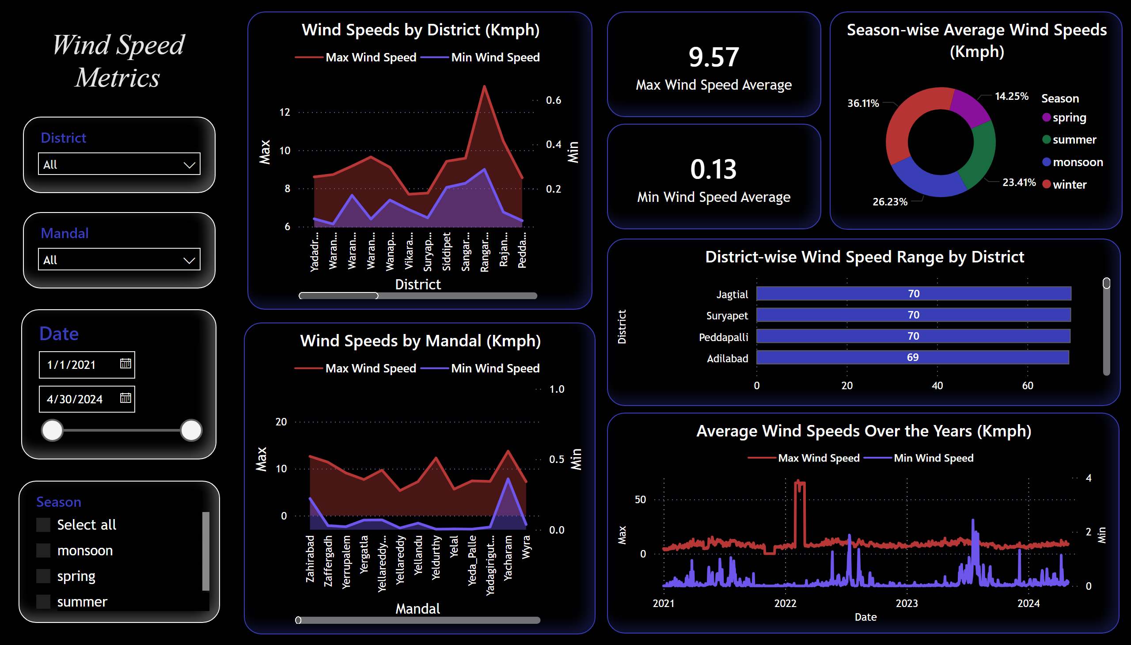
Wind Speed Metrics
Notes:
Season-wise Average Wind Speeds (Kmph)
No alt text provided
Average Wind Speeds Over the Years (Kmph)
No alt text provided
District-wise Wind Speed Range by District
No alt text provided
card
No alt text provided
card
No alt text provided
SeasonSlicer
No alt text provided
Date Slicer
No alt text provided
Mandal Slicer
No alt text provided
DSlicer
No alt text provided
logo
No alt text provided
Wind Speeds by Mandal (Kmph)
No alt text provided
Wind Speeds by District (Kmph)
No alt text provided

